Slide 1
OSMKerala Community Meetup 2023 Data Journalism in Kerala: Prospects and Challenges
Navaneeth T M
Research Fellow,
Department of Journalism and Mass Communication,
University of Calicut

Slide 2
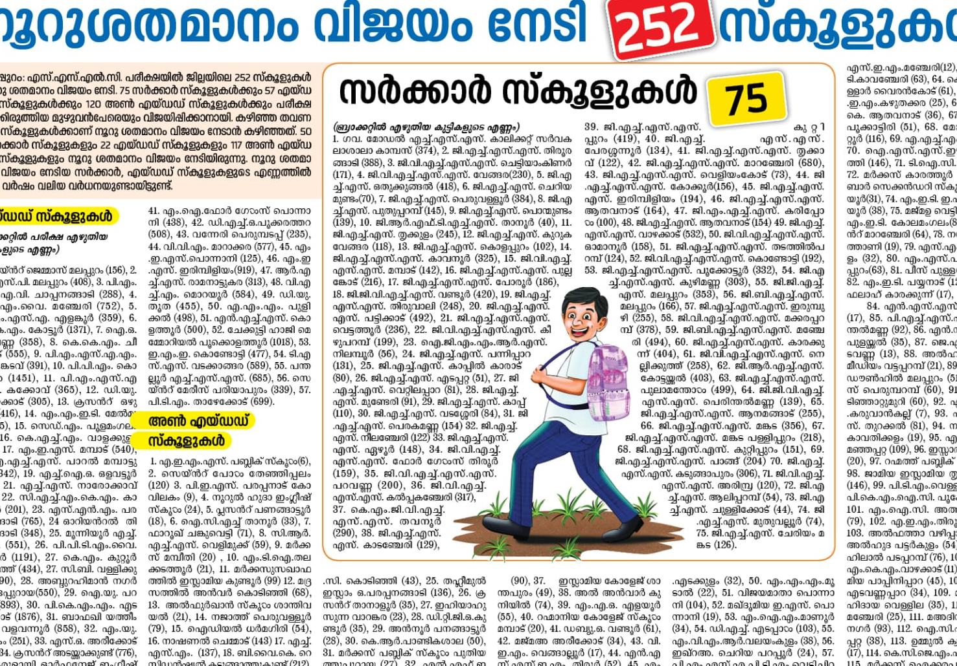
What is Data Journalism?
“Journalism done with data” (Gray, Bounegru & Chambers, 2012)

Slide 3
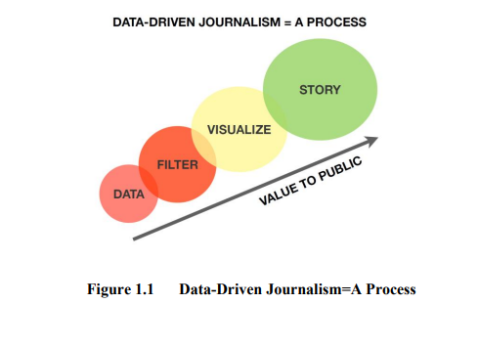
What is Data Journalism?
Philip Meyer: "Using numerical data to support what would otherwise be a weak news story.
Steve Doig: "The technique of turning raw data into news.“
While data has an ability to create knowledge in society, it needs to be analyzed before any news organization can create stories based on it (Rapeli, 2013, p. 19).

Slide 4
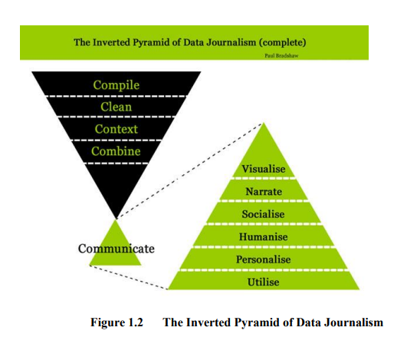
What is Data Journalism?
“gathering, cleaning, organizing, analyzing, visualizing, and publishing data to support the creation of acts of journalism” (Howard, 2014, p. 4).

Slide 5
Data Journalism in India - Examples
https://www.reuters.com/graphics/INDIA-ENVIRONMENT-WATER/0100B2C41FD/index.html
https://info-design-lab.github.io/TN2021/
https://www.indiaspend.com/agriculture/how-women-farmers-are-helping-transition-to-natural-farming-in-andhra-pradesh-837693
https://www.thehindu.com/data/data-balasore-tragedy-data-reveals-decline-in-train-accidents-but-indian-railways-safety-expenses-remain-low/article66937787.ece

Slide 6
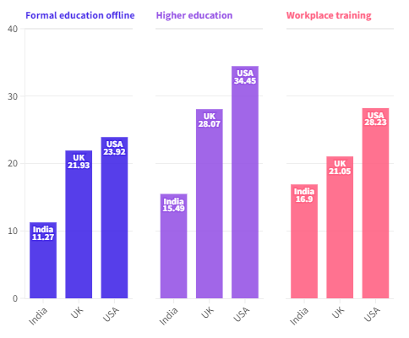
Data Journalism in India - Challenges
Lack of
Trained journalists
Support from the newsrooms

Slide 7
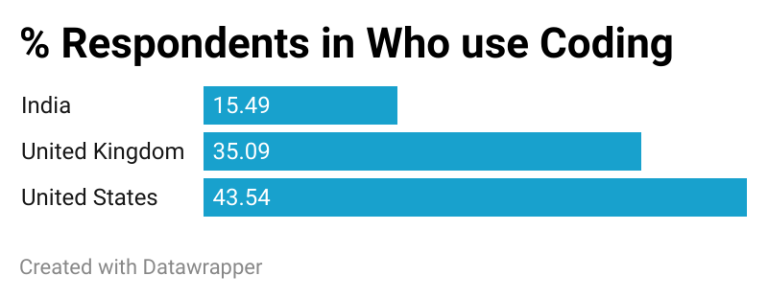
Data Journalism in India - Challenges
Lack of
Trained journalists
Support from the newsrooms

Slide 8
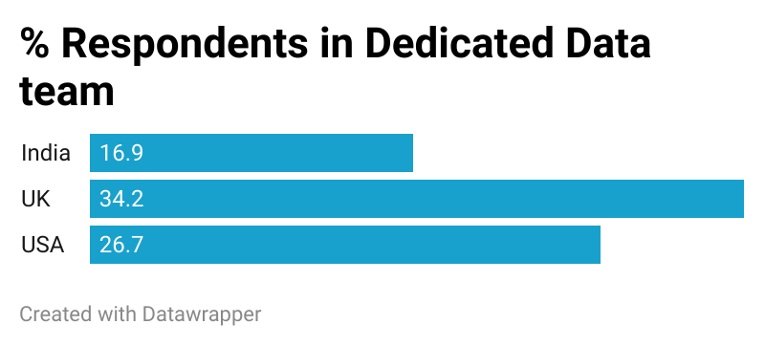
Data Journalism in India - Challenges
Lack of
Dedicated data team

Slide 9
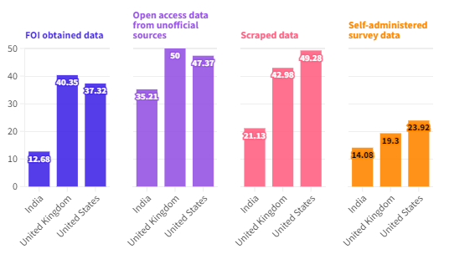
Data Journalism in India - Challenges
Over dependence on official/government data

Slide 10
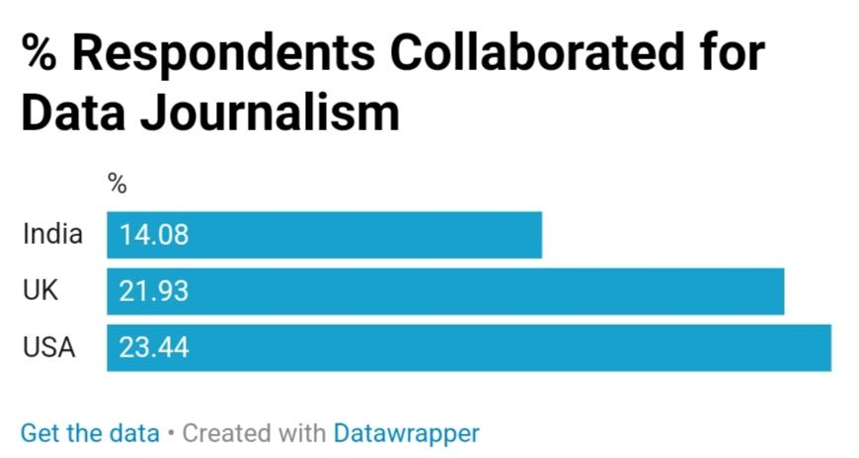
Data Journalism in India - Challenges
Lack of Collaborations

Slide 11
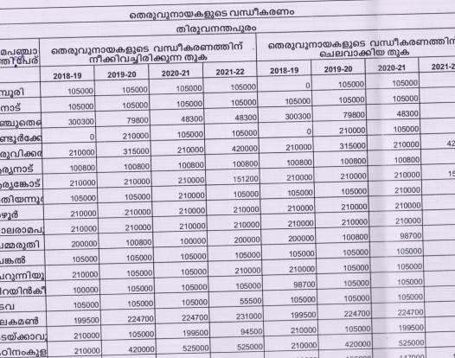
Data Journalism in Kerala - Challenges
Access to data sources
Insufficient and incomplete data
Inconsistent data
Availability of data

Slide 12
Data Journalism in Kerala - Challenges
Data visual literacy and ‘Sophistication’ of readers.
Dependence on governmental data
Lack of analysis
Questions of quality of data

Slide 13
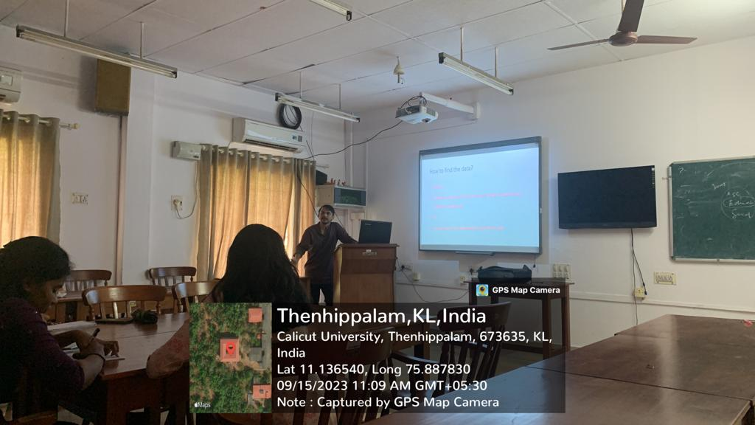
Challenges for Data Journalism education
Lack of time
Lack of computer skills among students
Fear of numbers and statistics

Slide 14
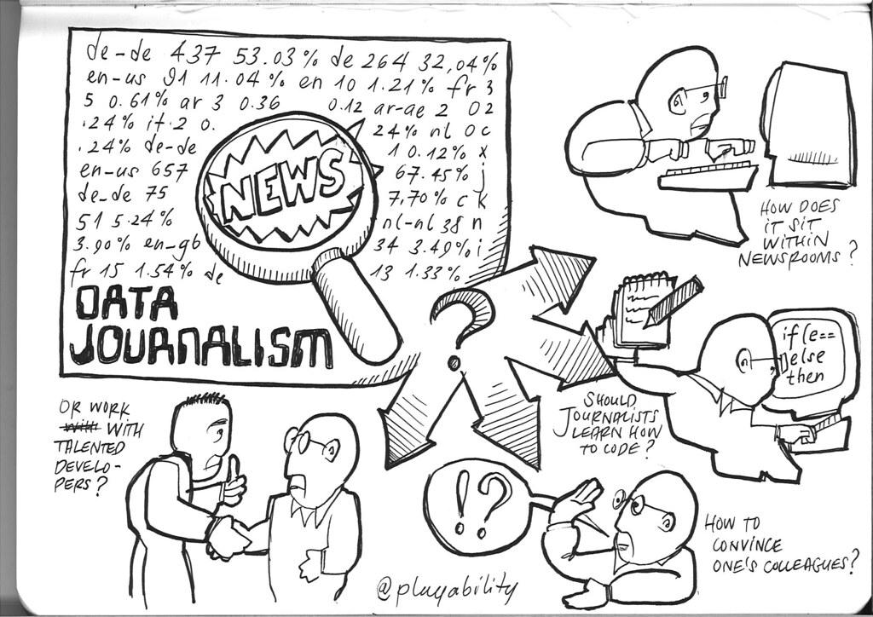
Data Journalism in Kerala - Prospects
Increasing awareness of data journalism and need for empirical evidence in storytelling
Journalism academia has started data journalism as a course.
Training programs and grassroots development

Slide 15
Data Journalism in Kerala - Prospects
Open data movement, crowdsourcing of data.
Emerging technologies
Rise of digital news outlets
Collaborative efforts

Slide 16
Thank You
Navaneeth T M
navaneeth.mcj@gmail.com
+916238062497

